Slide 1


React.js
Library, not a framework
Component-Based
Virtual DOM
Powered by

Slide 2
React.js
When to use:
SPAs
Highly Interactive apps
When NOT to use:
Static pages
Widgets
Powered by

Slide 3
React.js
Trouble starting:
ES6 (EcmaScript 2015)
Configuration Issues (Webpack, Babel)
New approach for doing stuff
Declarative vs Imperative Programming
Powered by

Slide 4

Redux
State management
One big javascript object
Transfers data (state) throughout the application
Powered by

Slide 5
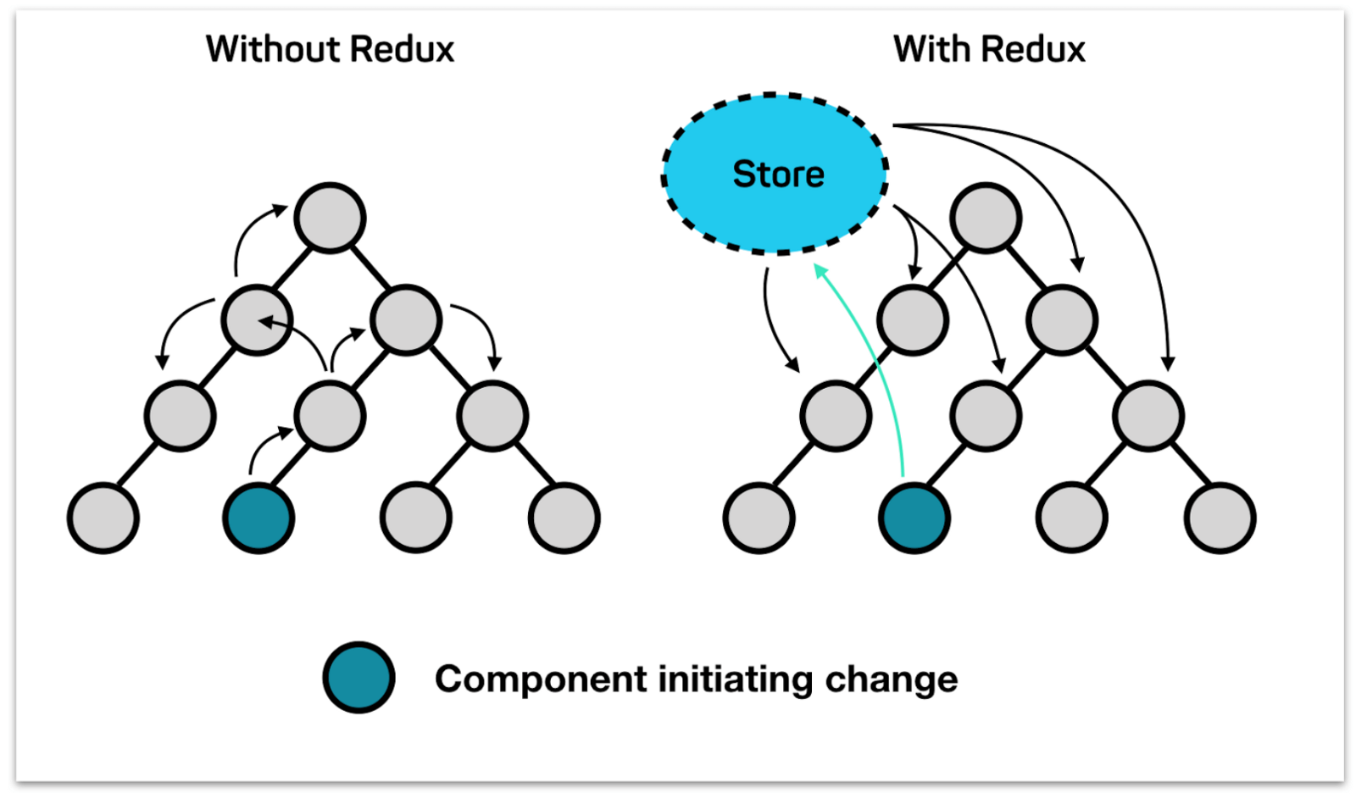
Redux
Powered by

Slide 6
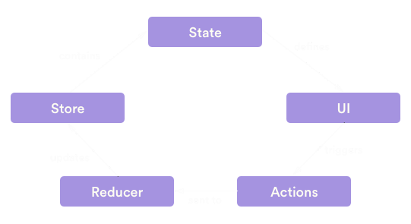
Redux
Powered by

Slide 7
Redux
Analogies with MVC
Actions = Controller
Whenever you want something to happen in your app (i.e. load some data, change a isLoading flag from true to false…) you will have to dispatch an action.)
Reducer = Model (Sort of)
Your reducers will be in charge of holding the current state of your application
Components = Views
Powered by

Slide 8
Fetch API
Issues with Fetch API
Handing error with fetch api.
Getting api response in 2 steps.
No timeout functionality available.
Cancelling request.
Fetch does not support upload progress.
No cookies by default
Powered by

Slide 9
Axios
Easy to send asynchronous HTTP request to REST endpoints
Make XMLHttpRequests from the browser
Make http requests from node.js
Supports the Promise API
Intercept request and response
Transform request and response data
Cancel requests
Automatic transforms for JSON data
Client side support for protecting against XSRF
Powered by

Slide 10
Redux-thunk middleware
A piece of code that sits between your actions and your reducers
Delay dispatch of an action.
Chain async actions.
Powered by

Slide 11

React Router
<BrowserRouter>
A <Router> that uses the HTML5 history API (pushState, replaceState and the popstate event) to keep your UI in sync with the URL.
<Switch>
Renders the first child <Route> or <Redirect> that matches the location.
(!) Renders a route exclusively.
<Route path="/" component={myComponent} />
Renders some UI when a location matches the route’s path.
<Link path="/">
Renders some UI when a location matches the route’s path.
Powered by

